Slide 1
Unilateral Mistake
Richard Warner
​

Slide 2
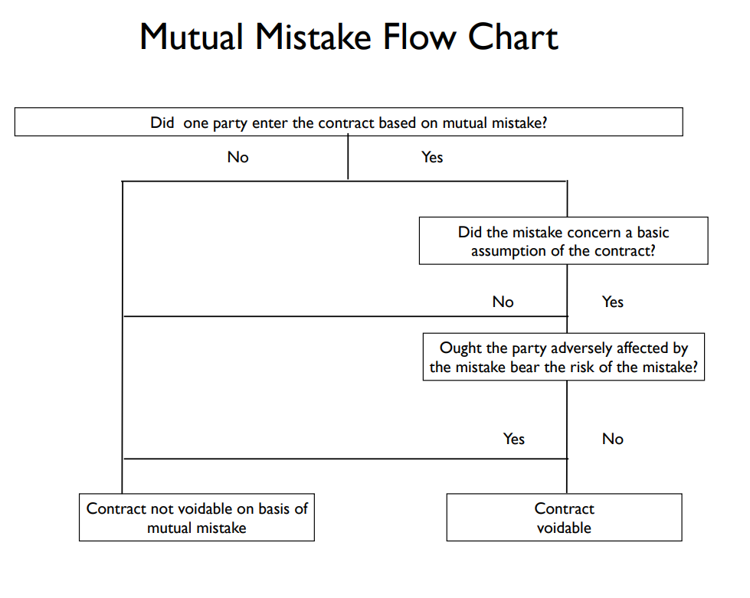

Slide 3
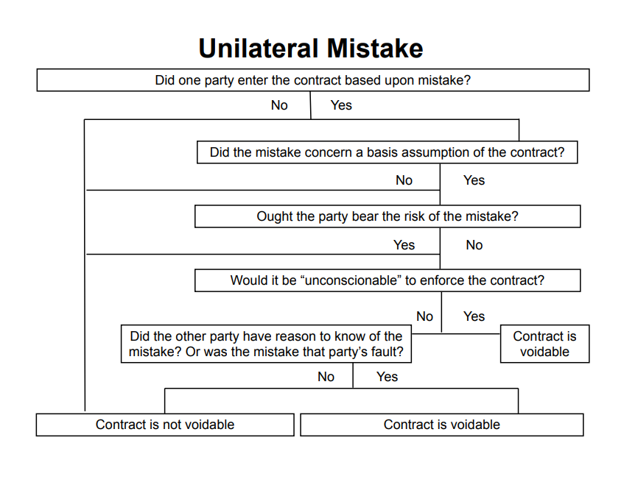

Slide 4
Elinsore Union v. Kastorff
What was the mistake here? The contractor added up his figures wrong; he submitted a bid just under $90,000 when he meant to bid just under $99,500.
The contractor discovered his mistake the next morning and tried to cancel, but the school dist. insisted that it was too late, that the contract has already been made.
The court held that the contractor could rescind the contract.

Slide 5

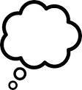
What Makes the Mistake Unilatera?
Correct
Correct
“My bid is correct.”

Slide 6
Who Ought to Bear the Loss?
Enforce
Not enforce
Contractor in underpaid/losing contract
Contractor not in underpaid/losing contract
Is the School Board no worse off than if mistake had not been made?
For a clear “Yes” make two more assumptions.

Slide 7
Variation 1
First assumption: The school district still has no way of realizing the mistake, but this time the contractor discovers the mistake prior to beginning work.
Second assumption: The school district can still accept the next lowest bid--say that was $97,000. This is not as good as the $90,000 contract, but they are no worse off than if the mistake had not been made. Then the $97,000 bid would have been the lowest.
We can take this as an example of a case in which it would be unconscionable to enforce the contract.

Slide 8
Variation 2
As in Variation 1, the contractor’s intended bid is $99,500 but he submits $90,000 by mistake.
Suppose the school district had no way of discovering the mistake, and the contractor did not notice it either. The contractor begins work, spends $50,000, and then notices the mistake.
Can the contractor get out of the contract?
(a) Yes
(b) No

Slide 9
Who Ought to Bear the Loss?
Enforce
Not enforce
Contractor in underpaid/losing contract
Contractor not in underpaid/losing contract
The School Board is NOT no worse off than if mistake had not been made.
We can take this as a clear case in which it is not unconscionable to enforce the contract.

Slide 10
Variation 3
The district has to put out a new round of bids.
This costs them $500 in administrative costs, and the new lowest bid is $98,000, not $97,000. Then the mistake has caused $1500 in damage.
Should the bidder be liable for this much? Many case reach such a result.

Slide 11
§ 272 Relief Including Restitution
(2) In any case governed by the rules stated in this Chapter, if those rules together with the rules stated in Chapter 16 will not avoid injustice, the court may grant relief on such terms as justice requires including protection of the parties' reliance interests.

Slide 12
Variation 4
Suppose the contractor was careless in submitting his bid; the bid is for $10,000 when all the other bids are between $90,000 - $100,000.
Imagine he types 10,000 instead of 90,000 and does not notice the error.
The school district does not say anything, it just accepts the bid.
Is the contractor excused on the basis of mistake?
(a) Yes
(b) No

Slide 13
Information and Control
The school board can easily avoid the mistake.

Slide 14
Mistakes Of Transcription And Misunderstanding
We have three more categories of mistakes to consider:
(1) Cases where the agreement was written down incorrectly;
(2) cases where one party was only joking;
(3) cases like Raffles v. Wichelhaus where the parties use the same word but have different things in mind.

Slide 15
Travelers Insurance Co. v. Bailey
This is a case where the agreement was written down incorrectly. What happened? The parties agreed on an insurance policy that would pay $500 a year to Bailey when he reached 65. But when they filled out the form, they wrote down that the payments would be $500 a month ($6000 a year).
Who is asking for a remedy?
The insurance company. What are they asking for?
For the contract to be reformed.

Slide 16
Reformation
Technically, this is an off the contract suit; the insurance company is not suing to enforce the contract but to have the contract rewritten, the way it should have been in the first place. The suit in reformation is an equitable cause of action; it doesn't charge anyone with breaching a contract. It just asks for the transcription error to be corrected.

Slide 17
Lucy v. Zehmer
What if the error was due to a joke, rather than a transcription erroris such a case. The buyer and seller were drunk--"higher than a Georgia pine"--the buyer offers to buy the seller's farm for $50,000. The seller thinks it is a joke and writes up a contract. The seller then tries to enforce the contract.
The court enforces the contract. The court finds that the buyer did not know that the seller was joking and enforces the contract. The rule is actually fairly well settled: if there is no way the other party could know it was a joke, the joker can't get out of the contract.

Slide 18
First Variation
The buyer has no idea the seller is joking. The buyer relies on the promise to sell--hires an architect, etc.
Who is the better position to avoid the misunderstanding and the loss here? The seller--by not making the joke, or making it clear that he was joking.
Did the joke cause harm? Yes, money was spent in reliance. So the seller should at least be liable for something; at least for the reliance damages.

Slide 19
Second Variation
It is obvious to everyone in the bar, including the buyer, that the seller is joking.
The buyer could have prevented the loss--the money spent in reliance--by not snapping up the offer and acting on it. This is a last clear chance case.
The buyer has the last clear chance to avoid the loss. This is the same point as in the mistake cases.

Slide 20
Third Variation
Suppose the buyer does not know the seller is joking and the buyer accepts the offer to sell, thinking it is a serious contract. Then, before the buyer acts in reliance, the seller reveals that he was joking. What should we do in this case?
This is like the mistake cases in which the mistake causes no loss, or just a little loss (where there was just a little reliance). There we said there was no contract. Shouldn't that be what we say here?

Slide 21
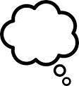
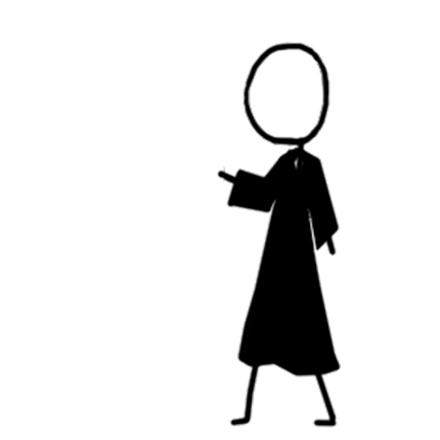
Same Word, Different Meanings
Could be early
Could be late
“Peerless”
Early Peerless
Late Peerless
The reasonable person.

Slide 22
Relevant trade usage?
Yes
No
Presumption is to interpret in accord with trade usage
Objective intent test adequately resolves any ambiguity?
Yes
No
Use objective intent test
Misunderstanding?
Yes
No
One party knows or should know of the misunderstanding?
Main purpose of the contract can be determined?
No
Yes
Yes
No
No contract under Restatement 201—note this may not be the result you want
Interpret against party with knowledge, etc.
Use hypothetical intent test
Use other strategies

